Slide 1

From Sign-Up to Success
Comprehensive Internship Capstone Project Consolidating Feature Engineering, Trend Discovery, and Predictive Churn Modeling
Presented By
Date:
Team 6
February 6, 2026

Slide 2
Problem Statement
Objectives
Excelerate wants to figure out why some students are dropping off from their chosen programs without completion and also develop a machine learning model that can help determine the likelihood of a learner dropping off in the course of a chosen program by ustilizing its historical data. This will allow Excelerate to take proactive measures to retain these students and improve overall learners’ completion rate.
To clean, transform and prepare raw data for analysis.
To explore and visualize data in order to uncover insights for a predictive model development.
To train and validate machine learning models that predicts the likelihood of a student dropping off from a program or getting rewarded to inform decision making.
To interpret model results and data findings in order to generate insights that drive decisions and strategies for enhancing student completion rates.
MISSION STATEMENT:

Slide 3
Workflow and Tools Employed
Workflow | Tool
Data Cleaning and Validation | Excel and Python (Pandas)
Feature Engineering | Python
Churn Analysis and Dashboard | Power Bi
Predictive Modeling | Python (Scikit-Learn Library)
Predictive Model | Random Forest Classifier
Report | Microsoft Word

Slide 4
Data Review and Preparation
Data Cleaning
Feature Engineering
The dataset contains 8556 rows and 16 columns.
3804 missing values were found, which is 2.778% of the dataset size. Columns with over 50% null values were dropped restructuring the dataset to 8263 rows by 15 columns.
The following new columns were created to facilitate predictive modeling: Applied_Flag, Signup_Apply_Delay_Days_Filled, Opportunity_Duration_(Days), Ongoing_Opportunity_Flag, Signup_Entry_Lag_Days, Learner_Age, Age_Group, Completed_Flag, Risk_Outcome, Region, Signup_Month, Signup_Year This restructure the dataset to 8263 rows by 27 columns

Slide 5
Dataset Overview
Dataset | Total Rows | Total Columns | Missing Value Count | Missing % | Full Duplicates
Raw Dataset | 8558 | 16 | 3804 | 2.778 | 0
Processed Dataset | 8263 | 27 | 0 | 0 | 0

Slide 6
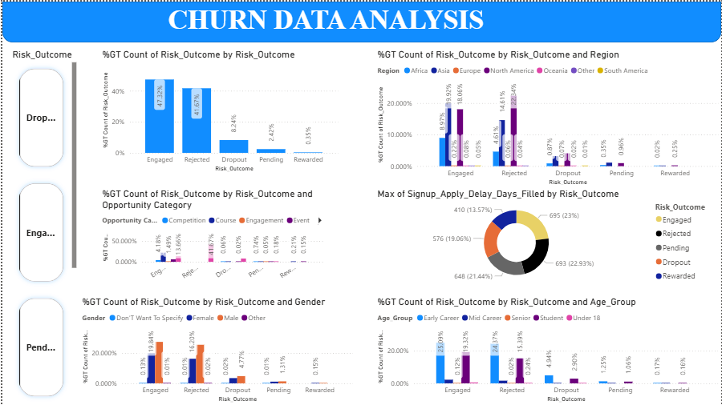
Churn Analysis Dashboard

Slide 7
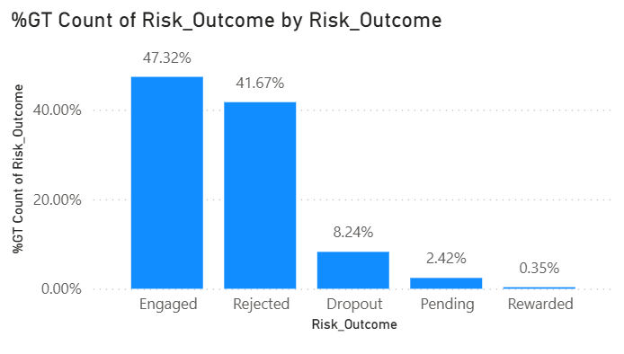
Churn Analysis: Risk Outcome Distribution
The dataset as displayed in the chart below shows that while 47.3% of students are Engaged, a massive 41.7% fall into the Rejected category, and 8.2% are explicitly marked as Dropout with only 0.35% Rewarded. This indicates that the primary "churn" occurs not just from students leaving, but from high barrier-to-entry (rejections).

Slide 8
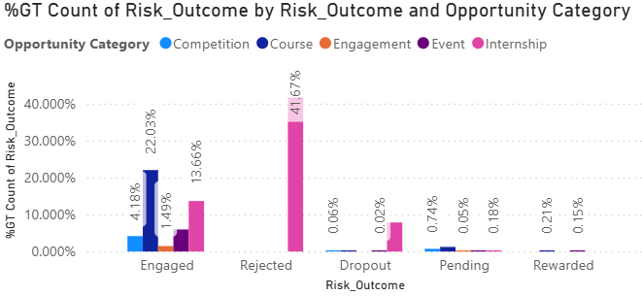
Churn Analysis: Risk Outcome Distribution by Opportunity Category
The chart shows that Internship opportunity (7.87%) leads to the highest rate of dropout while Course and Event are the leading opportunities resulting in learner’s getting rewarded

Slide 9
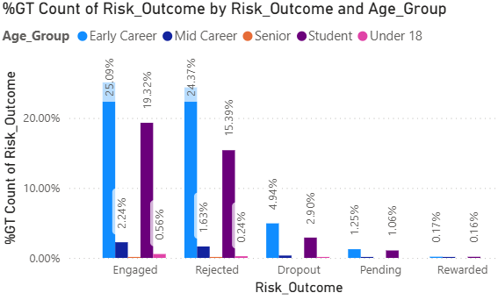
Churn Analysis: Risk Outcome Distribution by Age Group
This analysis reveals Early Career adopters(25.09%) and Students (19.32%) are the major categories of learner, however, they also contribute the most to the Dropout (Early Career-1.25%, Student-1.06%) and Rewarded (Early Career-0.17%, Student-0.16%) rates.

Slide 10
Churn Analysis: Risk Outcome Distribution by Age Group

Slide 11
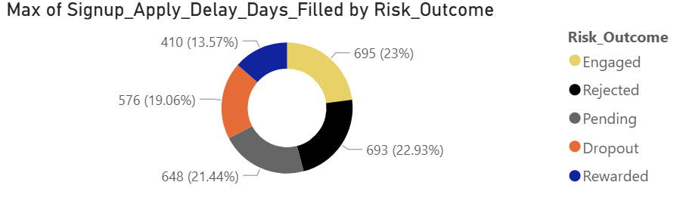
Churn Analysis: Risk Outcome Distribution by Maximum Period between Learners’ Signup and Application day.
The chart shows that the maximum period it takes a rewarded learner to apply for an opportunity is 410 days while dropout learners takes 576 days.

Slide 12
Churn Analysis: Risk Outcome Distribution by Maximum Period between Learners’ Signup and Application day.

Slide 13
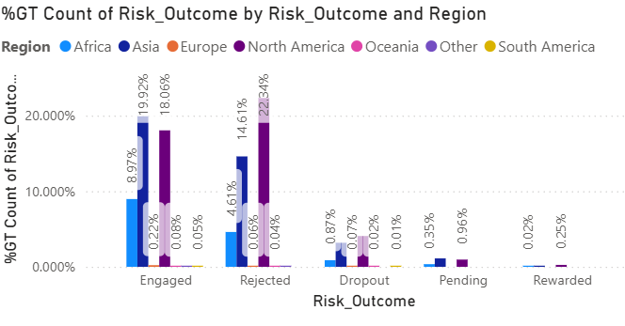
Churn Analysis: Risk Outcome Distribution by Region
This chart reveals dropout Learners’ are mostly concentrated in the North America (4.08%) and Asia (3.18) even though, they also contribute the most to the Dropout and Rewarded rates.

Slide 14
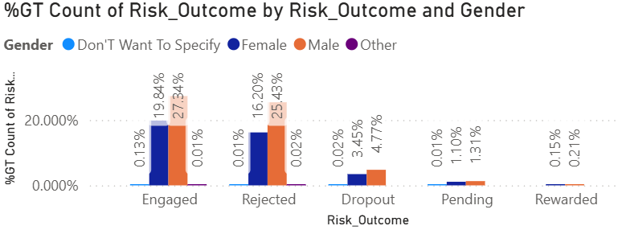
Churn Analysis: Risk Outcome Distribution by Gender
This chart shows that Male learners contributes the most to dropout rate (4.77%) compare with female learners (3.45%), however, male learners (0.21% Rewarded) also persist in staying through to the end of a program than female learners (0.15% Rewarded).

Slide 15
Predictive model: Model Selection
Model | Rationale
Decision Tree Classifier
Random Forest Classifier
The following models as shown in the table were considered during the predictive modeling.

Slide 16
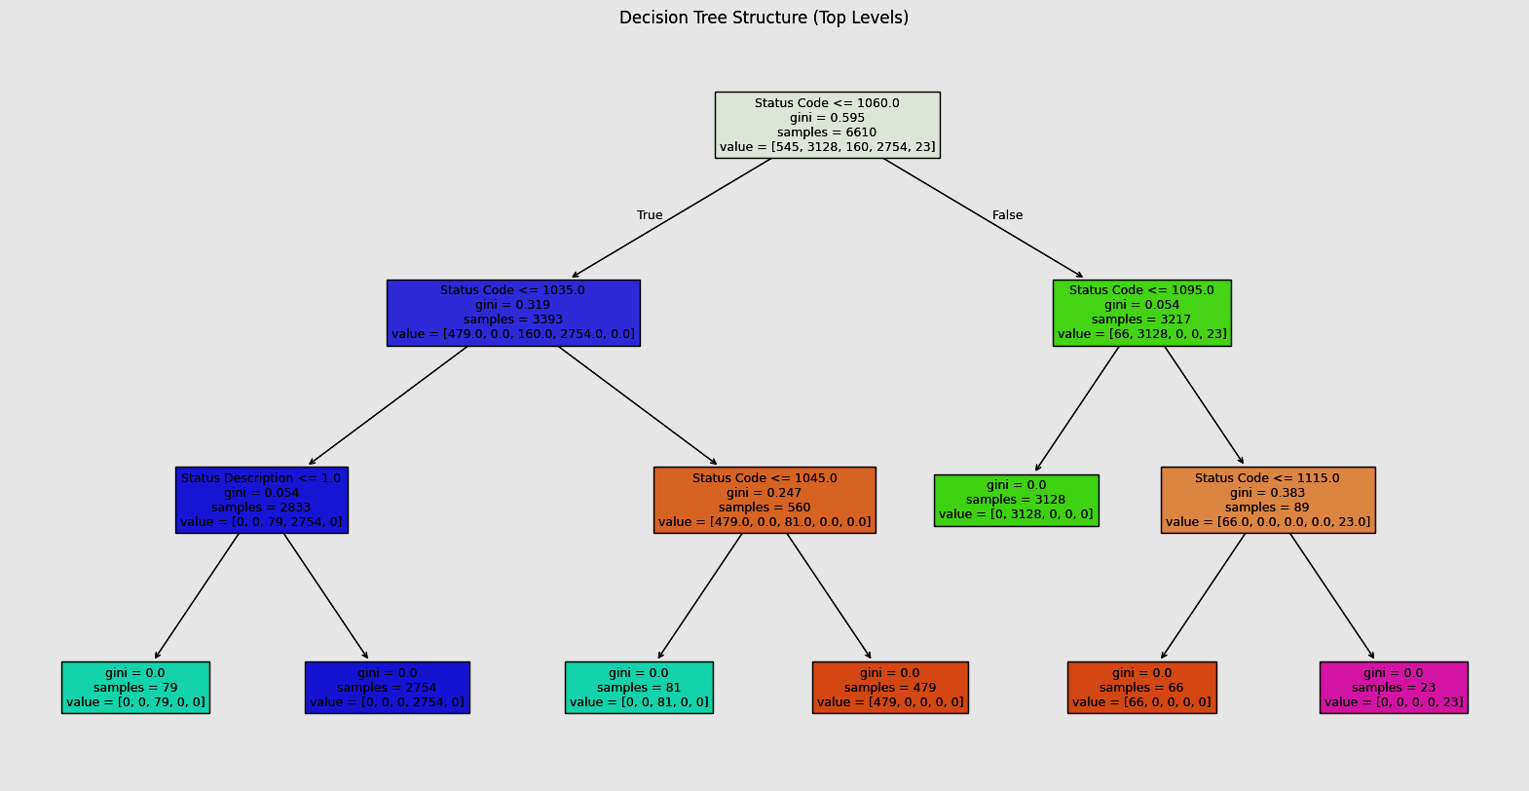
Predictive model: Model Structure
Random Forest Structure

Slide 17
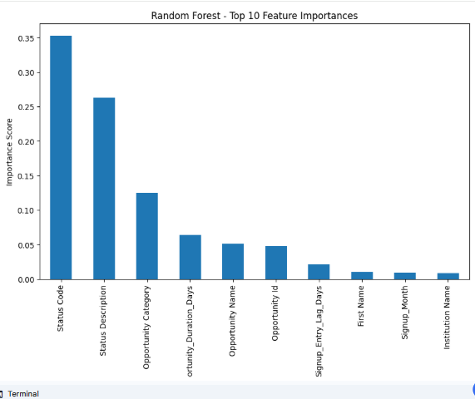
Predictive model: Feature Importance

Slide 18
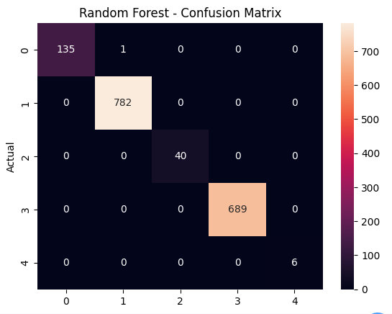
Predictive model: Model Performance Evalution with confusion matrix

Slide 19
Key Insights and Findings

Slide 20
Recommendations
Boost Engagement: Introduce interactive content and regular feedback to keep students motivated.
Enhance Support: Provide additional academic support and personalized assistance to struggling students.
Early Intervention: Identify at-risk students early and offer targeted support to prevent drop-offs.
Improve Course Design: Make courses more engaging and appropriately challenging to reduce drop-offs.

Slide 21
THANK YOU FOR LISTENINGOU

